Slide 1
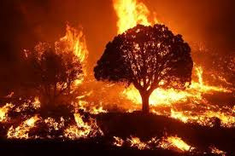
AUTOMATED SATELLITE-BASED
WILDFIRE DETECTION USING DEEP LEARNING
Progress Report on Data Collection, Preprocessing, and Model Developement

Slide 2
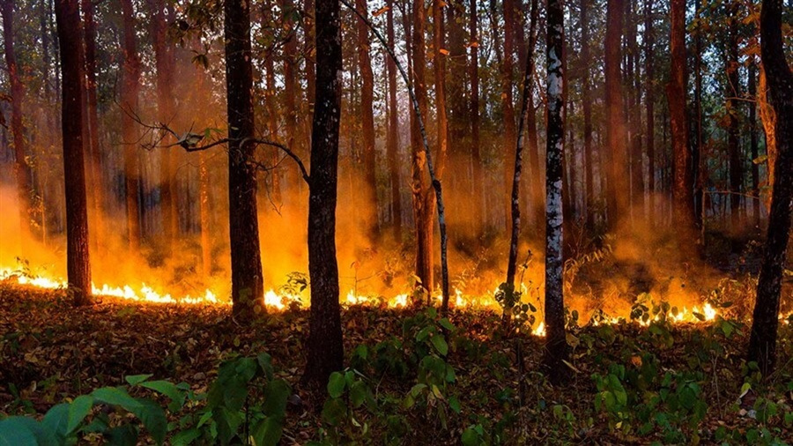
Introduction
3
•Climate change has driven a concerning rise in the frequency and severity of wildfires, resulting in irreversible ecological harm and annual economic losses surpassing billions of dollars. Conventional detection approaches—such as ground-based sensors and manual patrols—struggle with scalability and real-time monitoring limitations.
•Satellite remote sensing, leveraging platforms like Moderate Resolution Imaging Spectroradiometer (MODIS) and Sentinel-2, provides a promising alternative by delivering high-resolution thermal and optical imagery for fire surveillance. Breakthroughs in deep learning, including convolutional neural networks (CNNs) and image segmentation models, highlight transformative potential for automating wildfire detection systems. Despite progress, critical challenges remain: the scarcity of real-time detection frameworks, underutilized fusion of multimodal data sources, and gaps in adapting models to diverse geographic regions

Slide 3




Objectives
3
Classification and Segmentation
Time Series Model
Data Collection
Use FIRMS Data from NASA to access, download and process satellite images and CAL Fire historical data
Develope Time-Series Model For Predicting Fire Spread
Train CNNs (MobileNetV2) and U-net for image classification/segmentation.

Slide 4
Data Collection
4
TFor this research, two data sources are used.
Fire Information for Resource Management System (FIRMS)
California Department of Forestry and Fire Protection (CAL FIRE)

Slide 5

FIRMS
5
The Fire Information for Resource Management System (FIRMS) is a platform developed by NASA to provide near real-time active fire data to natural resource managers and the public. Utilizing satellite observations from the Moderate Resolution Imaging Spectroradiometer (MODIS) and the Visible Infrared Imaging Radiometer Suite (VIIRS), FIRMS delivers active fire locations globally within approximately three hours of satellite observation.

Slide 6
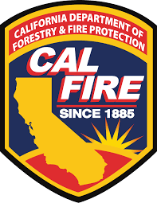
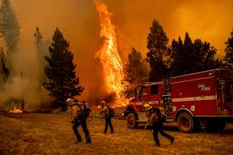
FIRMS
6
The California Department of Forestry and Fire Protection (Cal Fire) is the primary fire protection agency under the California Natural Resources Agency. It is responsible for safeguarding 31 million acres of state-designated wildfire-prone land, as well as managing both public and private forests.

Slide 7
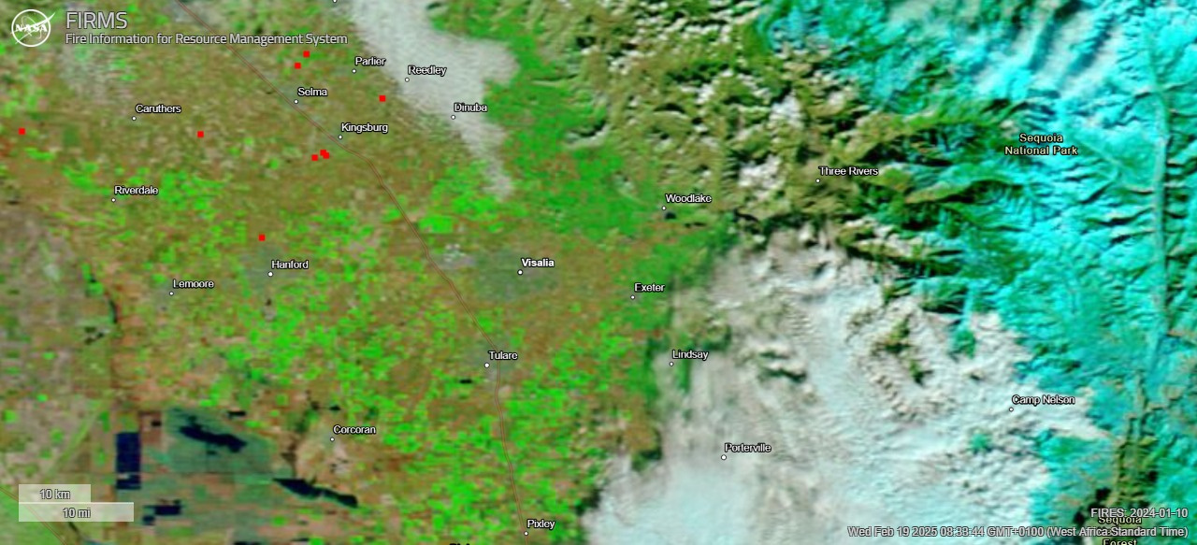
Sample Data
7
Satelitte Data
Data covers California Area
Each red spot represents fire/hotspots picked up by all three FIRMS satelitte
MODIS/Terra is used over as dynamic image to check reflectance of vegetation and burned areas.

Slide 8
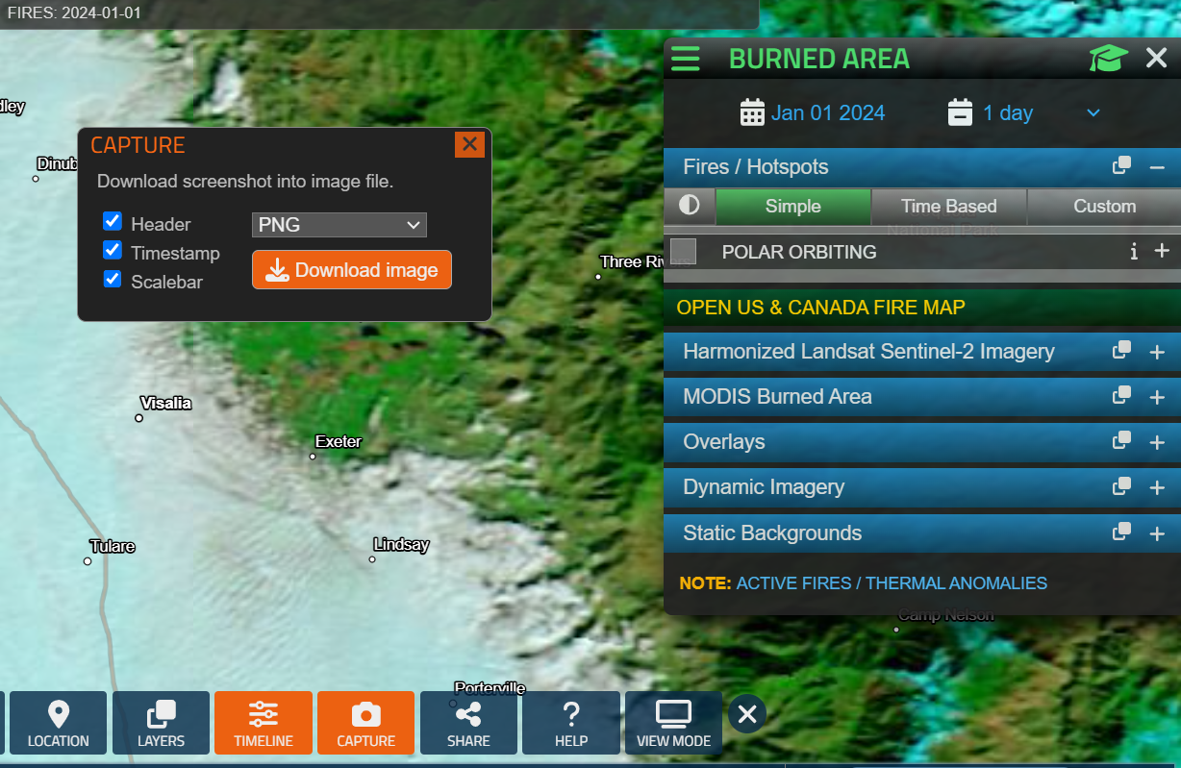
Classification data storage
8
Image captured covers a one day range for a period of 1 year (2024 - 2025).
These images are captured as a PNG file and saved Locally for Model Training.
Folder structure:
data/
├── fire/ # Images with ≥1 hotspot
└── no_fire/ # Images with 0 hotspots

Slide 9

Segmentation data Preprocessing
9
Segmentation Model (MobileNetV2)
Goal: Pixel-wise fire localization.
Input: Satellite image.
Output: Binary mask (fire regions = 1).
Loss: Dice Loss (handles class imbalance).

Slide 10

Model Development
10
Classification Model (Fire vs. No-Fire)
Architecture: Transfer learning with MobileNetV2 (pre-trained on ImageNet).
Input: 256x256x3 PNG images.
Output: Binary label (0/1).
Metrics: Precision, Recall, F1-Score.

Slide 11

Model Development
11
Segmentation Model (regions affected by wildfire)
Architecture: Transfer learning with U-net (pre-trained on).
Input: Masked fire affected images
Output: Binary label (0/1).
Metrics: Accuracy, IoU.

Slide 12

Model Development
12
Time Series Model (predict the likelihood of wildfires)
Architecture: Fbprophet based on CAL FIRE History data
Input: Alarm dates, fire count & acres burned
Output: Future data/predictions.
Metrics: Accuracy, MAE, RMSE, MAPE.

Slide 13
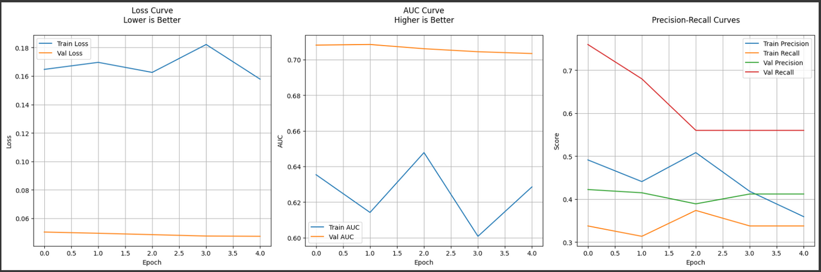
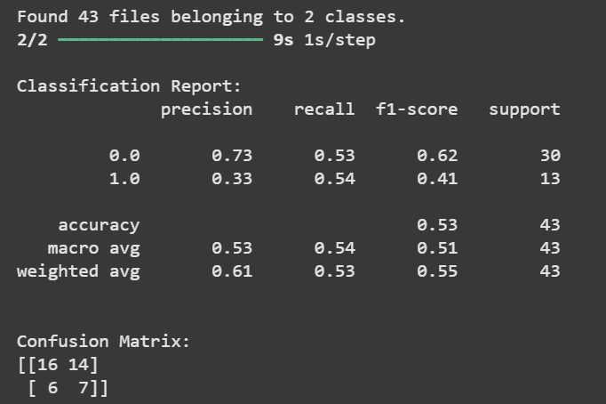
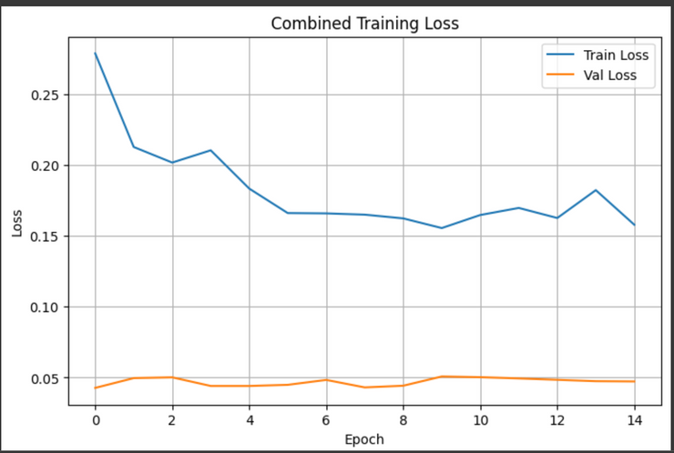
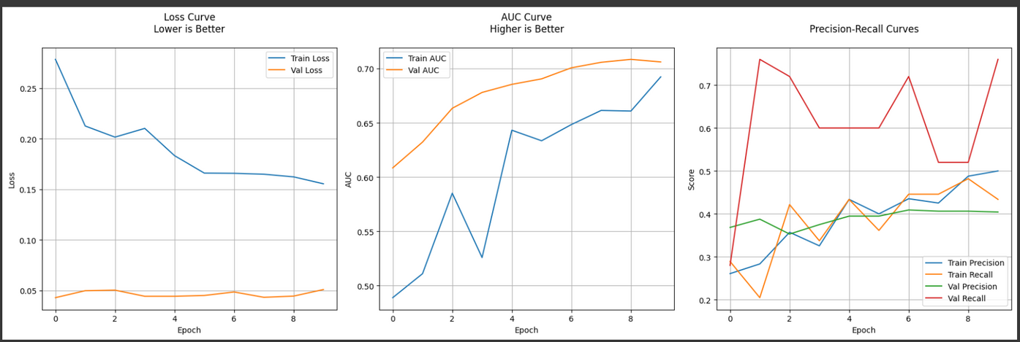
Model Evaluation
13
Classification
Phase 1 (head training)
Classification Report
Phase 2 (fine tuning)

Slide 14
Model Evaluation
14
Classification
Classification Report
The wildfire classification model achieved 53% accuracy, with a recall of 54% for fire detection and precision of 33%, indicating difficulty in correctly identifying fire occurrences. The training loss fluctuated around 0.16 - 0.18, while validation loss remained stable at ~0.05, suggesting potential underfitting. The AUC score (~0.70 for validation) indicates moderate discrimination between fire and no_fire classes. The confusion matrix highlights misclassification issues, with 14 false positives and 6 false negatives. Improvements such as handling class imbalance, transfer learning, and better feature extraction could enhance performance.

Slide 15
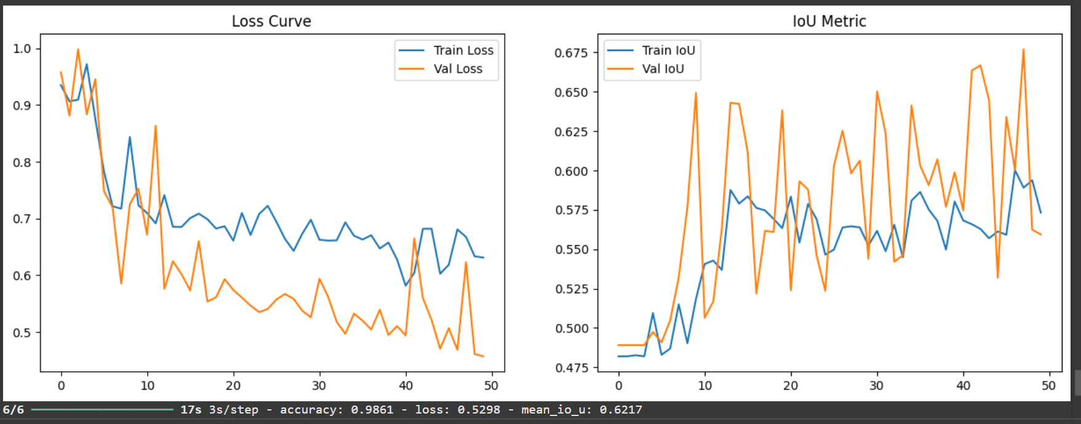
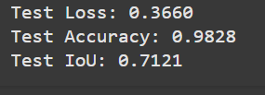
Model Evaluation
15
Segmentation
Test set evaluation

Slide 16
Model Evaluation
16
Segmentation
Test set evaluation
The wildfire segmentation model performed well, achieving a test accuracy of 98.28% and an IoU score of 0.7121, indicating strong overlap between predicted and actual fire regions. The training process resulted in mean IoU of 0.6217, suggesting consistent segmentation quality. The test loss of 0.3660 is relatively low, reflecting a well-optimized model. While the results are promising, further refinements, such as data augmentation, higher-resolution imagery, and post-processing techniques, could enhance segmentation accuracy, making it more robust for real-world wildfire detection and monitoring.

Slide 17
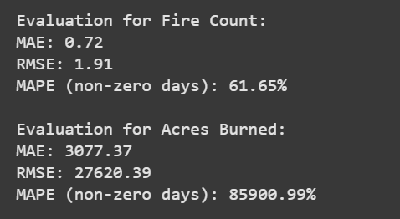
Model Evaluation
17
Time series
Evaluation Metrics
The time series forecasting model demonstrated moderate accuracy in predicting fire counts but struggled with acres burned estimation. The MAE of 0.72 and RMSE of 1.91 for fire count predictions indicate relatively low error, though the MAPE of 61.65% for non-zero days suggests variability in predictions. For acres burned, the high MAE (3,077 acres) and RMSE (27,620 acres) highlight challenges in capturing extreme variations, with a MAPE of 85,900.99% suggesting significant errors on days with reported fires. These results indicate the need for feature engineering, external data sources (e.g., weather, wind speed), and model tuning to improve forecasting accuracy.

Slide 18
Recommendations
18
Segmentation: Improve night-time detection using VIIRS Day/Night Band
Future Works
Classification: Incorporate multi-temporal image stacks for fire progression context
Forecasting: Integrate CFSv2 weather forecasts and Palmer Drought Index
With better performance and validation, deployment for real-time testing is adviced

Slide 19

THANK
YOU

